Slide 1
Introduction to Python

Slide 2
1 About Python…

Slide 3
Python is a popular programming language created by Guido Van Rossum and released in 1991.
A High-Level language.
Used for
Web Development.
Software Developments.
Mathematical Applications.
Data mining and machine learning.

Slide 4
2 Why Python ?

Slide 5
Simple and easier to learn.
Powerful.
A free language.
Works on different platforms (Windows, Mac, Linux, Raspberry PI)
Allows to run the code as soon as it is written.

Slide 6
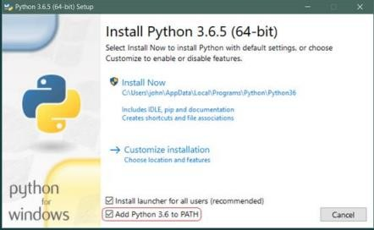
Installing Python…
Step 1: Download the Python 3 Installer https://www.python.org/downloads/windows/
Step 2: Run the Installer

Slide 7
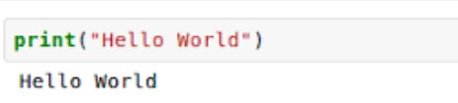
Print…
To display strings or content of variables , python use print statement
print(“Hello World”)
It simply print out a line and it also include a newline, unlike C programming language.

Slide 8

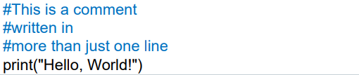
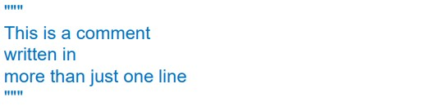
Comments…
To display a comment # can be used. Comments does not have to be text to explain the code, it can also be used to prevent Python from executing code.

Slide 9
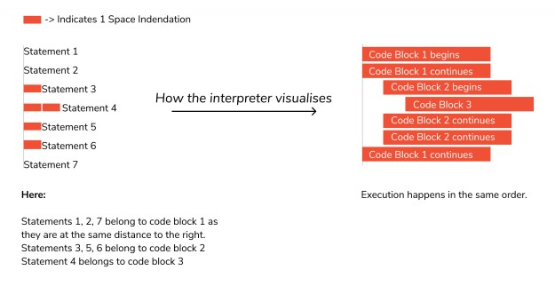
Indentation…
Python uses indentation for blocks, instead of curly braces.

Slide 10


A variable is a reserved memory location used for storing data values.
In python there is no command for declaring a variable.
Declaration happens automatically when a value is assigned to a variable.
Data type of the variable can be changed even after its being set.

Slide 11


Several variables can be assigned a single value simultaneously.
Multiple values can be assigned to several variables at a time.

Slide 12
Rules of naming a variable…
Must start with a letter or underscore
character.
Cannot start with a number
Can contain only alpha numerical characters and underscore. (A-z , 0-9, _ )
Special symbols cannot be used as
variables like !, @, #, $, % etc.
Keywords cannot be used as identifiers / variables.

Slide 13
Case Sensitive.
city = “Kandy”
City = “Colombo”
- city and City are two different variables
Variables must be meaningful. a = 9
number = 9

Slide 14
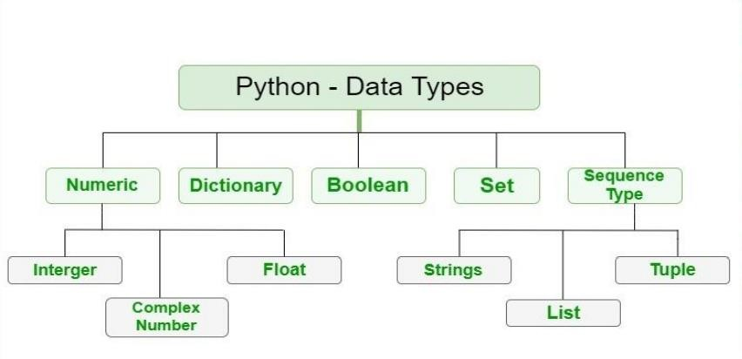


Slide 15

Concatenation with a variable…
Assume that you want to print a number which assign to a variable with text.

Slide 16


Taking an input from the User…
Assume that you want to print a number which assign to a variable with text.
Prompt can be a String or representing a default message before the input.

Slide 17
Task 01

Slide 18
Write a python program to get User’s name and age as the user input display following greeting message :
“
“Hello <User’s Name> and you are
<User’s Age> Years Old”

Slide 19
Write a python program to get 2 numbers from the user and print the total as the output .
Display following message :
“
“Sum of the 2 numbers: <sum>”

Slide 20
Write a python program to get 2 numbers from the user and print the total and the average as the output .
Display following message :
“
“Sum of the 2 numbers: <sum>” “Average : <average>”

Slide 21

Thanks!
ANY QUESTIONS?

